Slide 1
Intent Recognition Example
atjahyanto@gmail.com

Slide 2
Dataset CLINC150
Dataset benchmark untuk tugas Intent Recognition pada chatbot dan asisten virtual.
Berasal dari paper Larson et al., 2019, “An Evaluation Dataset for Intent Classification and Out-of-Scope Prediction.”
Benchmark dataset for Intent Recognition tasks in chatbots and virtual assistants.
From the paper Larson et al., 2019, “An Evaluation Dataset for Intent Classification and Out-of-Scope Prediction.”
https://aclanthology.org/D19-1131/

Slide 3
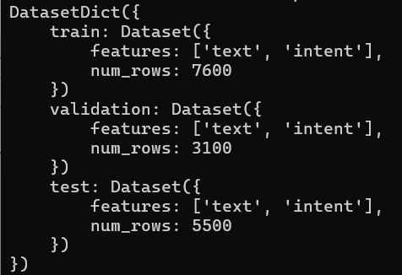
Dataset Structure
from datasets import load_dataset
dataset = load_dataset("clinc_oos", "small")
print(dataset)
print(dataset["train"].features)

Slide 4
Pre-trained model: DistilBERT
DistilBERT is a lightweight variant of BERT designed to maintain high performance while reducing model size and inference speed.
model = DistilBertForSequenceClassification.from_pretrained(
"distilbert-base-uncased",
num_labels=num_labels
)

Slide 5
Tokenizer
Serves to break down text into small units such as words, sub-words, or characters, which are called tokens.
# load tokenizer
tokenizer = DistilBertTokenizerFast.from_pretrained("distilbert-base-uncased")
# transform the entire dataset, translating raw text into numeric tokens (input IDs, attention masks).
dataset = dataset.map(lambda x: tokenizer(x["text"], padding=True, truncation=True), batched=True)
{
'input_ids': [101, 1045, 2293, 17953, 102]
'attention_mask': [1, 1, 1, 1, 1]
}
"I love nlp"

Slide 6
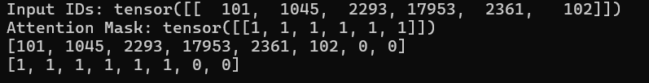
Tokenizer Example
from transformers import BertTokenizer
from datasets import load_dataset
from datasets import Dataset
tokenizer = BertTokenizer.from_pretrained("bert-base-uncased")
sentences = ["I love nlp", "I love you", "you love me too", "unaffordable and affordable"]
data = [{"text": s} for s in sentences]
# Konversi ke HuggingFace Dataset
dataset = Dataset.from_list(data)
dataset = dataset.map(lambda x: tokenizer(sentences, padding=True, truncation=True), batched=True)
encoded = tokenizer(sentences[0], padding=True, truncation=True, return_tensors="pt")
# Ambil input_ids dan attention_mask
input_ids = encoded["input_ids"]
attention_mask = encoded["attention_mask"]
# Tampilkan hasil
print("Input IDs:", input_ids)
print("Attention Mask:", attention_mask)
print (dataset["input_ids"][0])
print (dataset["attention_mask"][0])
Transformers version: 4.45.2
Datasets version: 2.18.0

Slide 7
Regular vs BERT Tokenizer

Slide 8
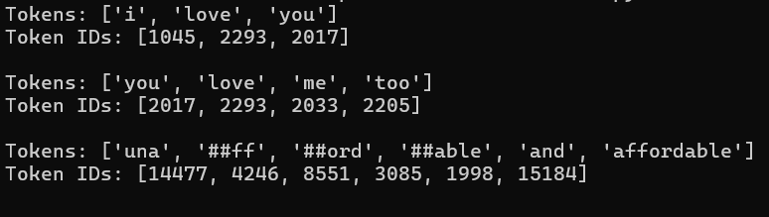
Subword Tokenization
from transformers import BertTokenizer
tokenizer = BertTokenizer.from_pretrained("bert-base-uncased")
sentences = ["I love you", "you love me too", "unaffordable and affordable"]
for sentence in sentences:
# Tokenisasi dan konversi ke ID
tokens = tokenizer.tokenize(sentence)
token_ids = tokenizer.convert_tokens_to_ids(tokens)
print("Tokens:", tokens)
print("Token IDs:", token_ids)
print ()
Breaking words into units smaller than full words (subwords), but larger than characters.
Provides an efficient solution to the Out-Of-Vocabulary (OOV) word problem.
complex words like unaffordable that may not be in the model vocabulary will be broken down into:
un → common prefix
##affordable → base word with prefix “##” indicating that this token continues from the previous token

Slide 9
Training Arguments
training_args = TrainingArguments(
output_dir= nmModel,
num_train_epochs=10,
per_device_train_batch_size=4,
logging_dir="./logs",
logging_steps=10,
save_strategy="no",
report_to="none",
load_best_model_at_end=True,
metric_for_best_model="eval_loss",
greater_is_better=False
)

Slide 10
Trainer Initialization
trainer = Trainer(
model=model,
args=training_args,
train_dataset=dataset["train"],
eval_dataset=dataset["test"],
tokenizer=tokenizer
)

Slide 11
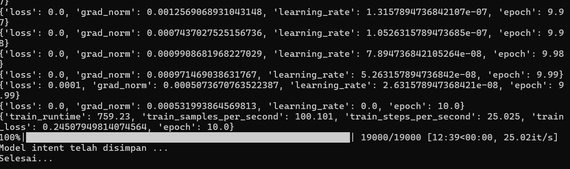
Train the Intent Model
from datasets import load_dataset
import evaluate
import numpy as np
import torch
#-------------------------------------
from datasets import Dataset, DatasetDict
from sklearn.preprocessing import LabelEncoder
from transformers import (
DistilBertTokenizerFast,
DistilBertForSequenceClassification,
Trainer,
TrainingArguments
)
ditraining = 1 # 1 - retrain the model, 0 - use the pretrained model
dataset = load_dataset("clinc_oos", "small")
print (dataset)
# menyusun ulang dataset yang akan digunakan
# data training
text_list = dataset["train"]["text"]
label_list = dataset["train"]["intent"]
num_labels = len(np.unique(label_list))
data = {
"text": text_list,
"label": label_list
}
le = LabelEncoder()
data["label_enc"] = le.fit_transform(label_list )
train_dataset = Dataset.from_dict({
"text": data["text"],
"label": data["label_enc"]
})
# data testing
text_list = dataset["test"]["text"]
label_list = dataset["test"]["intent"]
data = {
"text": text_list,
"label": label_list
}
le = LabelEncoder()
data["label_enc"] = le.fit_transform(label_list )
test_dataset = Dataset.from_dict({
"text": data["text"],
"label": data["label_enc"]
})
# dataset final
dataset = DatasetDict({
"train": train_dataset,
"test": test_dataset
})
print (dataset)
# kode
datasetSatu = 0
nmModel = f"./intent-model-{datasetSatu}"
print (dataset)
# ========= 3. Tokenisasi =========
tokenizer = DistilBertTokenizerFast.from_pretrained("distilbert-base-uncased")
dataset = dataset.map(lambda x: tokenizer(x["text"], padding=True, truncation=True), batched=True)
training_args = TrainingArguments(
output_dir= nmModel,
num_train_epochs=10,
per_device_train_batch_size=4,
logging_dir="./logs",
logging_steps=10,
save_strategy="no",
report_to="none",
load_best_model_at_end=True,
metric_for_best_model="eval_loss",
greater_is_better=False # karena loss makin kecil makin bagus
)
if (ditraining==1):
# ========= 4. Load Model & Fine-tuning =========
model = DistilBertForSequenceClassification.from_pretrained(
"distilbert-base-uncased",
num_labels=num_labels
)
device = torch.device("cuda" if torch.cuda.is_available() else "cpu")
model.to(device)
mythreshold = 0.001
from transformers import TrainerCallback, TrainingArguments, Trainer
import math
class LossThresholdCallback(TrainerCallback):
def __init__(self, threshold=mythreshold):
self.threshold = threshold
def on_evaluate(self, args, state, control, metrics, **kwargs):
eval_loss = metrics.get("eval_loss", None)
if eval_loss is not None and eval_loss < self.threshold:
print(f"\n⛔ Stopping early: eval_loss ({eval_loss:.6f}) < {self.threshold}")
control.should_training_stop = True
return control
trainer = Trainer(
model=model,
args=training_args,
train_dataset=dataset["train"],
eval_dataset=dataset["test"],
tokenizer=tokenizer,
callbacks=[LossThresholdCallback(threshold=mythreshold)]
)
trainer.train()
# 9. Save model
trainer.save_model(nmModel)
tokenizer.save_pretrained(nmModel)
print ("Model intent telah disimpan ...")
# ========= 5. Inference / Chatbot ========= sini
model.eval()
print ("Selesai...")
import sys
sys.exit(1)
else:
#--------------------
import evaluate
accuracy = evaluate.load("accuracy")
def compute_metrics(eval_pred):
logits, labels = eval_pred
predictions = np.argmax(logits, axis=-1)
return accuracy.compute(predictions=predictions, references=labels)
# 10. Load model kembali
model_loaded = DistilBertForSequenceClassification.from_pretrained(nmModel)
tokenizer_loaded = DistilBertTokenizerFast.from_pretrained(nmModel)
print (f"Model {nmModel} loaded ...")
# 11. Evaluasi model yang dimuat ulang
trainer_loaded = Trainer(
model=model_loaded,
args=training_args,
eval_dataset=dataset["test"],
tokenizer=tokenizer_loaded,
compute_metrics=compute_metrics,
)
results = trainer_loaded.evaluate()
print("\n\nEvaluasi Model Setelah Load:", results)
To make the training faster, use num_train_epochs = 3

Slide 12
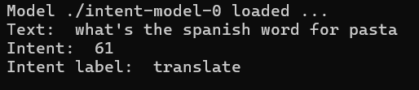
Predict the Intent
from datasets import load_dataset
import evaluate
import numpy as np
import torch
#-------------------------------------
from datasets import Dataset, DatasetDict
from sklearn.preprocessing import LabelEncoder
from transformers import (
DistilBertTokenizerFast,
DistilBertForSequenceClassification,
Trainer,
TrainingArguments
)
dataset = load_dataset("clinc_oos", "small")
# menyusun ulang dataset yang akan digunakan
# data training
text_list = dataset["train"]["text"]
label_list = dataset["train"]["intent"]
label_intent = np.unique(label_list)
num_labels = len(label_intent)
label_name = dataset["train"].features["intent"].names
my_dict = dict(zip(label_intent, label_name))
le = LabelEncoder()
label_enc = le.fit_transform(label_list )
datasetSatu = 0
nmModel = f"./intent-model-{datasetSatu}"
model = DistilBertForSequenceClassification.from_pretrained(nmModel)
device = torch.device("cuda" if torch.cuda.is_available() else "cpu")
model.to(device)
tokenizer = DistilBertTokenizerFast.from_pretrained(nmModel)
print (f"Model {nmModel} loaded ...")
user_input = "what's the spanish word for pasta"
inputs = tokenizer(user_input, return_tensors="pt").to(device)
with torch.no_grad():
output = model(**inputs)
pred = output.logits.argmax(dim=-1).item()
intent = le.inverse_transform([pred])[0]
print ("Text: ", user_input)
print ("Intent: ", intent)
print ("Intent label: ", my_dict[intent])
Try these sentences:
i would like to transfer $100 from my checking to saving account
set a timer for 10 minutes
can you tell me what dendrofilous means
can you help me locate my phone
Try with your own sentence:
?

